Slide 1
React
Events - UI Elements - Forms, Lists - Sass
Mahhek Tahir
Notes:
.

Slide 2
Event Handling
Events are user interactions like clicks, key presses, form submissions.
React uses synthetic events to handle events consistently across browsers
Events are handled using event handlers like onClick, onChange.
Example of an inline event handler:
<button onClick={() => alert("Button clicked!")}>Click Me</button>
Event handlers in React are written as functions and passed to elements using JSX attributes.

Slide 3
Event - Functional Components
Functional components make event handling easier with simple function calls.
const handleClick = () => alert("Button clicked!");
<button onClick={handleClick}>Click Me</button>

Slide 4
Passing Parameters in Events
function handleClick(name) {
alert(`Hello, ${name}!`);
}
<button onClick={() => handleClick("John")}>Click Me</button>
Use arrow functions to pass parameters in event handlers.

Slide 5
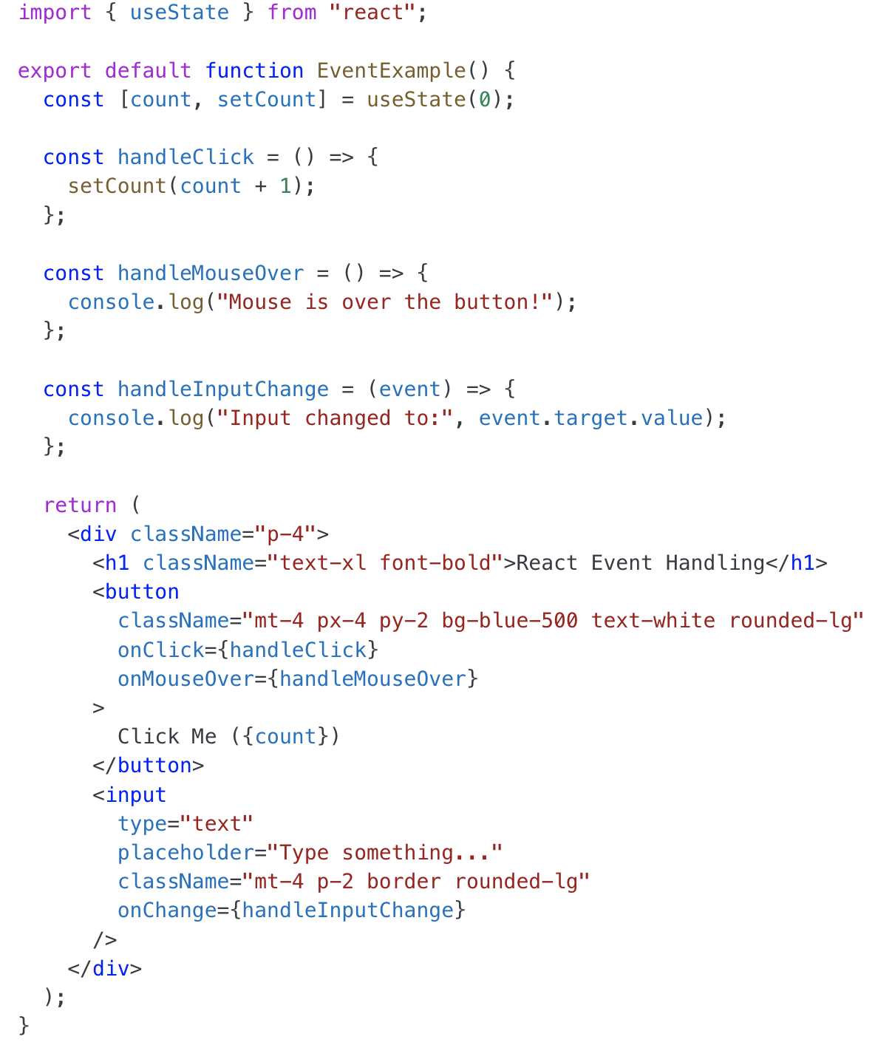
Example

Slide 6
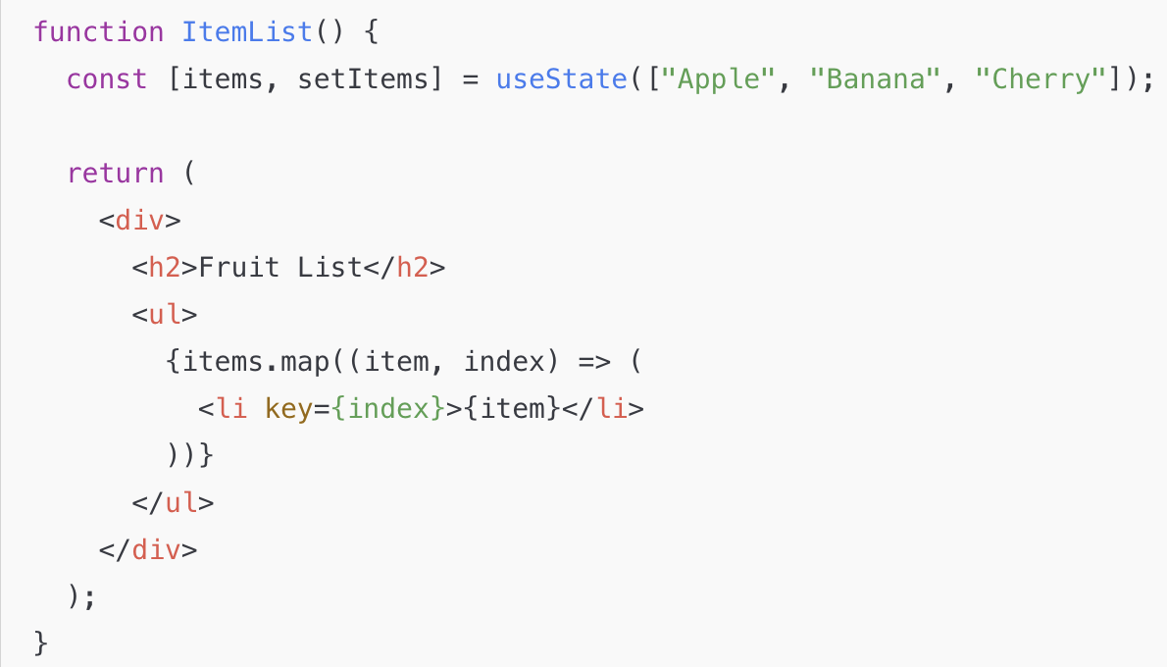
UI Elements - Lists
Use .map() to generate list items dynamically

Slide 7
UI Elements - Form
Forms are controlled using state.
Example: Simple Form with one field.
import { useState } from 'react';
function Form() {
const [name, setName] = useState('');
return <input value={name} onChange={(e) => setName(e.target.value)} />;
}

Slide 8
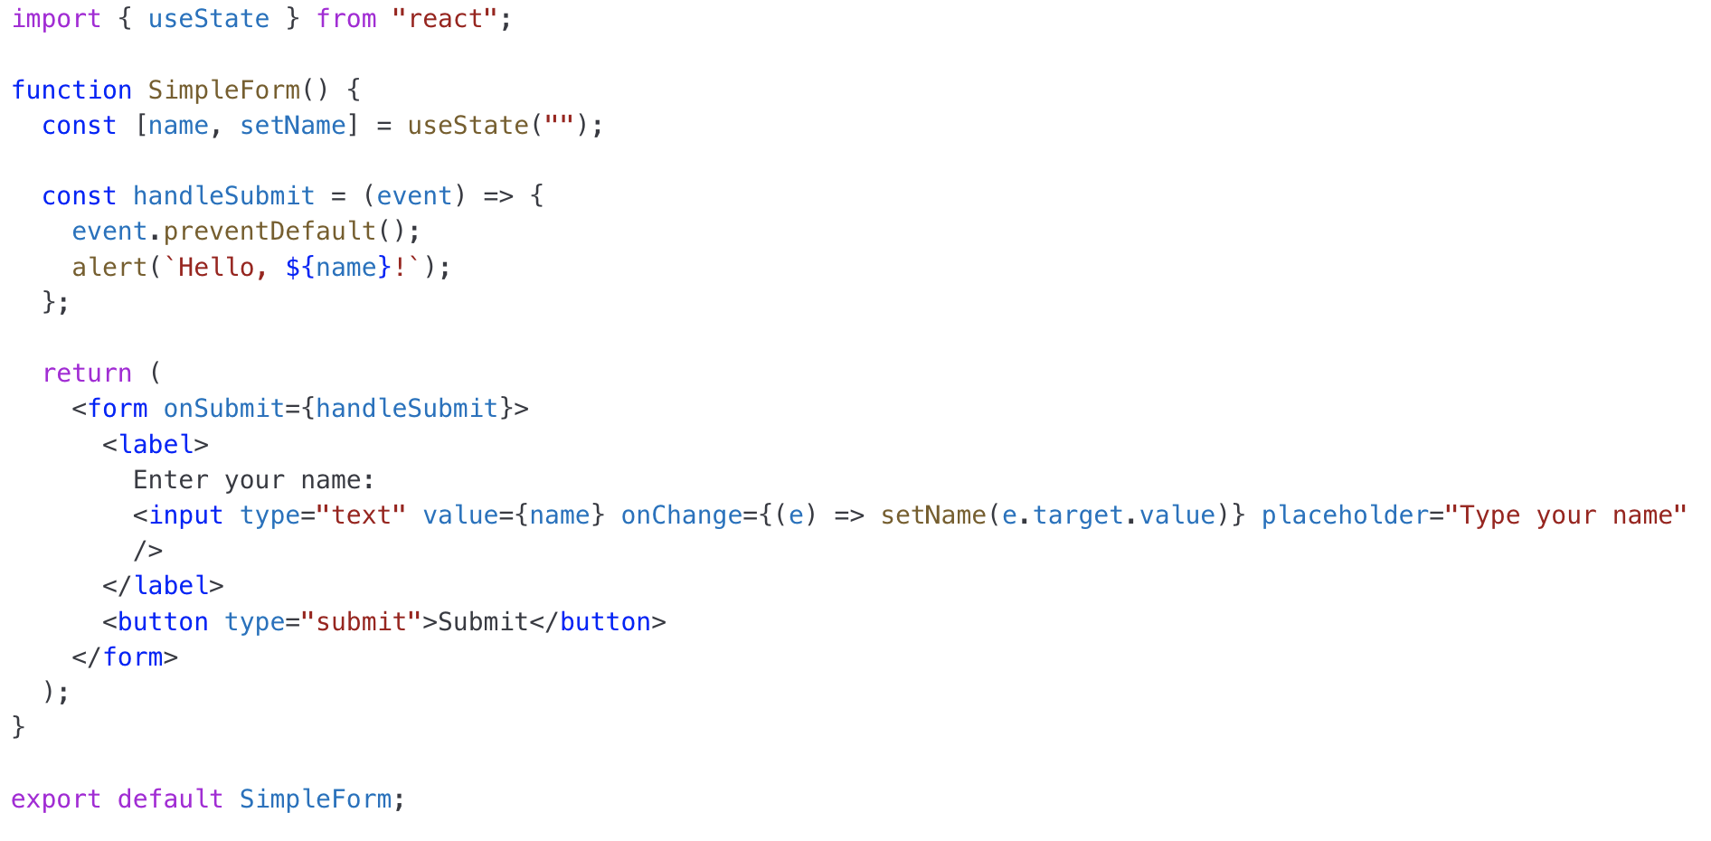
UI Elements - Form
Forms are controlled using state.
Example: Simple Form with one field.

Slide 9
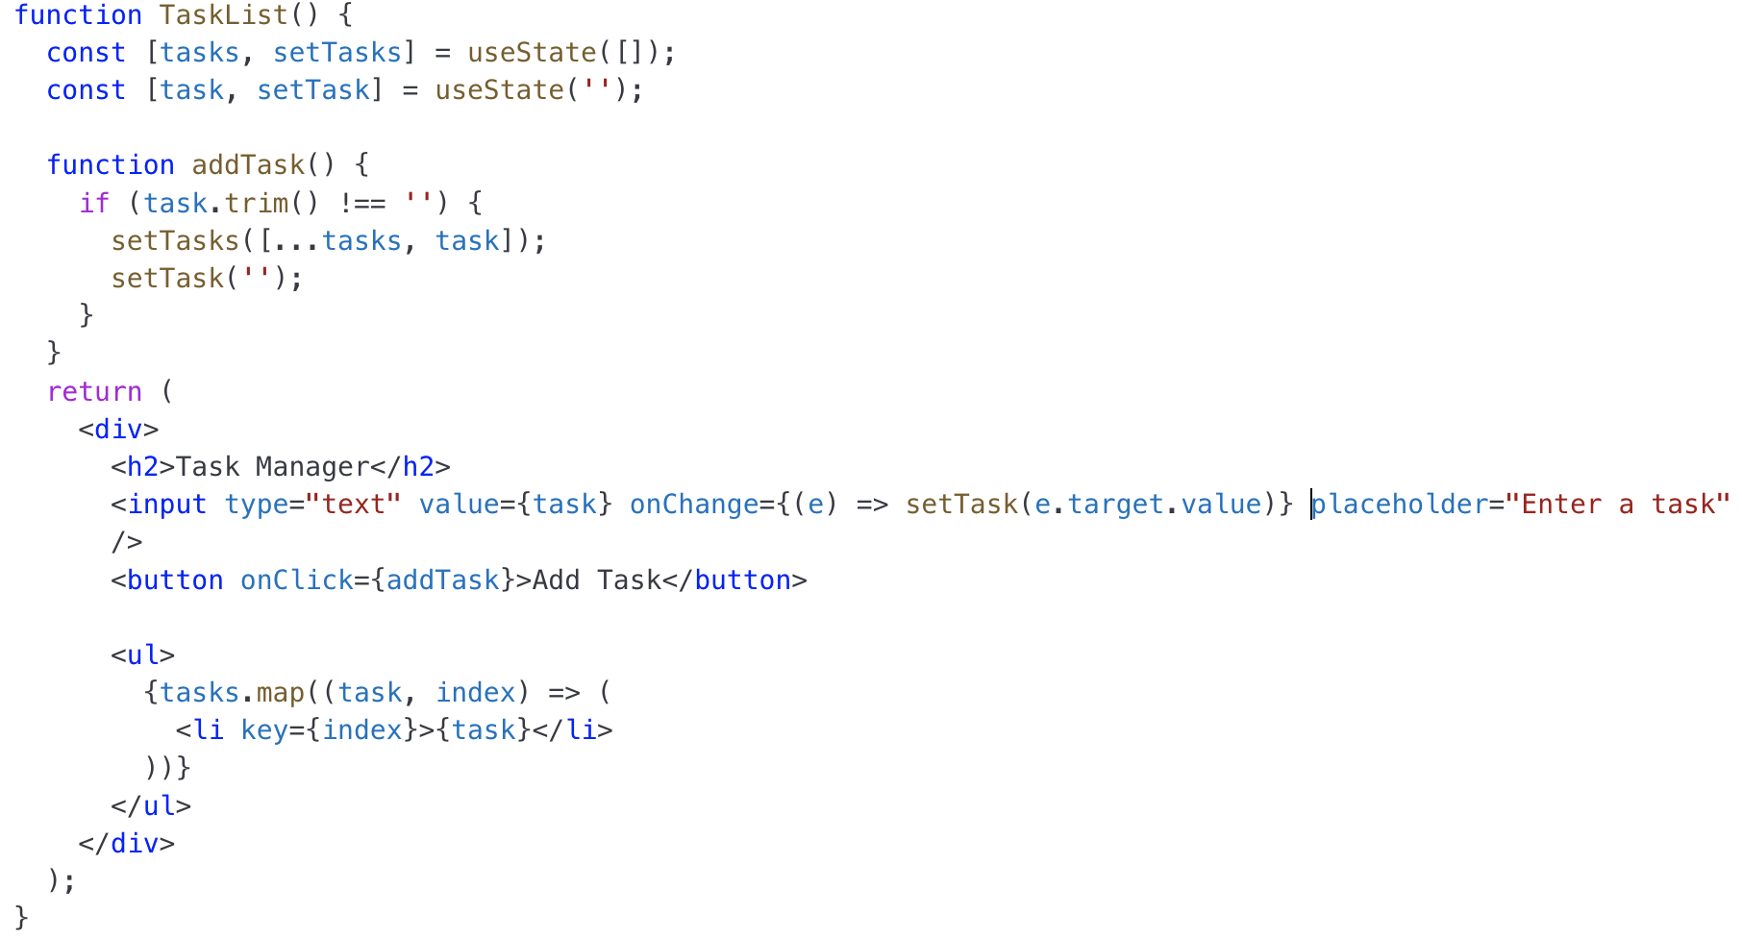
UI Elements - Adding Task

Slide 10
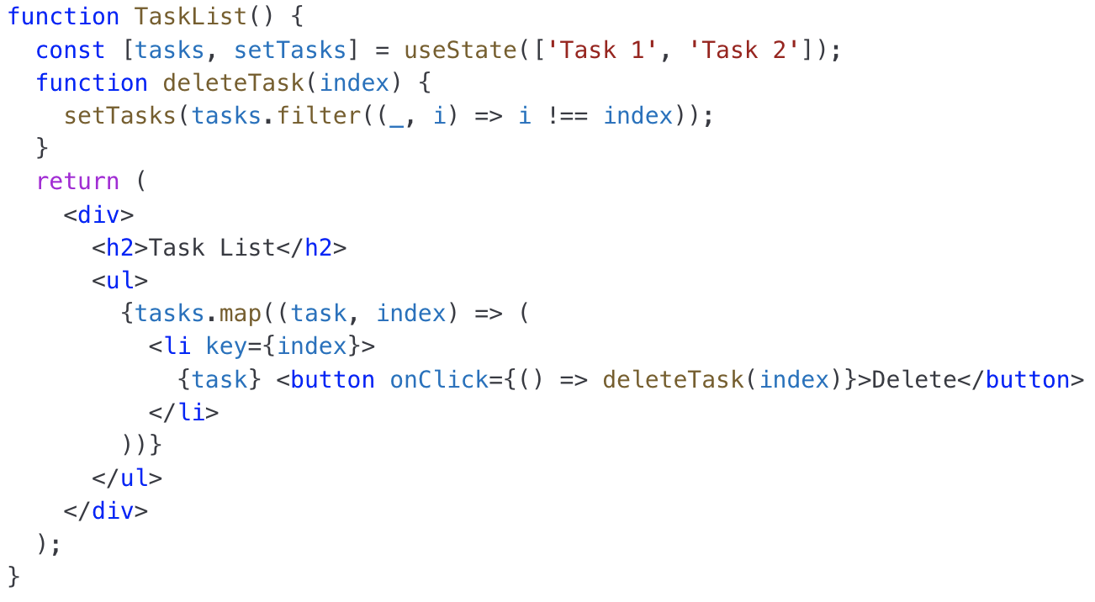
UI Elements - Deleting Task

Slide 11
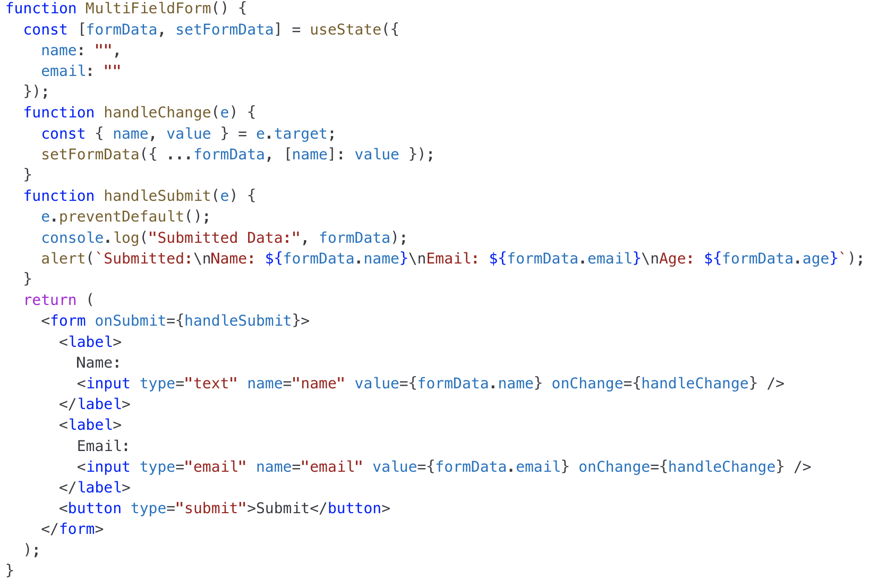
Multiple fields Form
Example: Multiple Element Form

Slide 12
Styling in REACT
Client-side programming with React involves managing the user interface and interactions on the browser. When it comes to styling in React, two popular approaches are CSS and SASS.

Slide 13
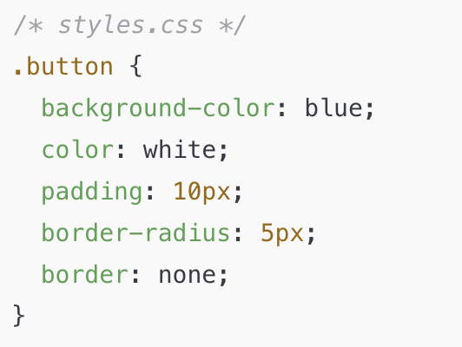
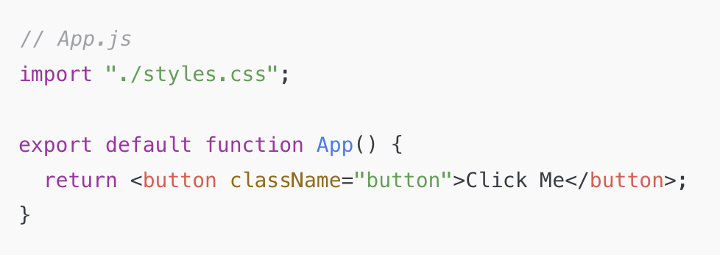
CSS
React supports standard CSS stylesheets that can be imported into components.
You can define styles in a .css file and import them in your component:

Slide 14
SASS in React
SASS (Syntactically Awesome Stylesheets) is a CSS preprocessor that allows variables, nesting, mixins, and functions.
npm install sass
// styles.scss
$primary-color: purple;
.button {
background-color: $primary-color;
border-radius: 5px;
}

Slide 15
Nested Style
// Nested styles
.container {
padding: 20px;
.button {
background: green;
color: white;
}
}

Slide 16
Mixins
@mixin button-styles($bg-color, $text-color) {
background-color: $bg-color;
color: $text-color;
padding: 10px;
border-radius: 5px;
border: none;
}
.primary-button {
@include button-styles(blue, white);
}
.secondary-button {
@include button-styles(gray, black);
}

Slide 17
Extending Styles
.button {
background-color: blue;
color: white;
padding: 10px;
border-radius: 5px;
}
.rounded-button {
@extend .button;
border-radius: 50px;
}

Slide 18
Functions in SASS
// styles.scss
@function calculate-width($columns) {
@return $columns * 100px;
}
.container {
width: calculate-width(3); // 300px
}

Slide 19
Conditions in SASS
@mixin theme($mode) {
@if $mode == dark {
background-color: black;
color: white;
} @else {
background-color: white;
color: black;
}
}
.dark-theme {
@include theme(dark);
}
.light-theme {
@include theme(light);
}

Slide 20
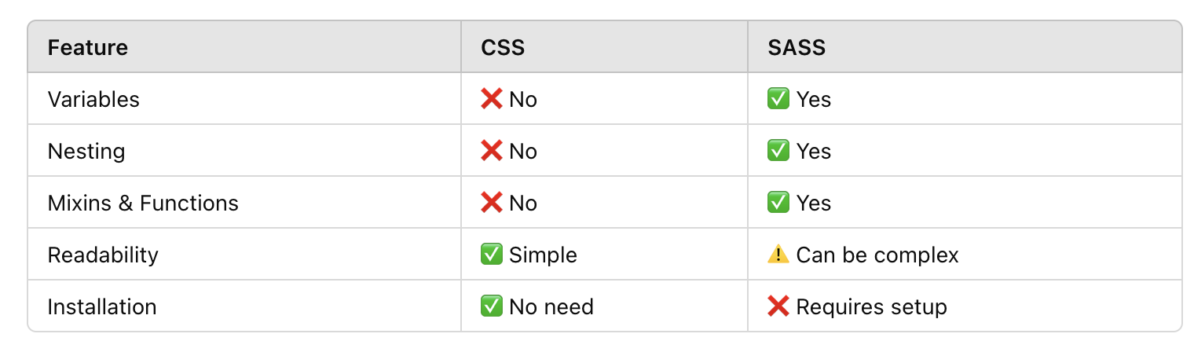
CSS VS SASS

Slide 21
Various UI Elements
Example Code with UI Elements, Preview and Show data in table below
File name complex_form

